Slide 1
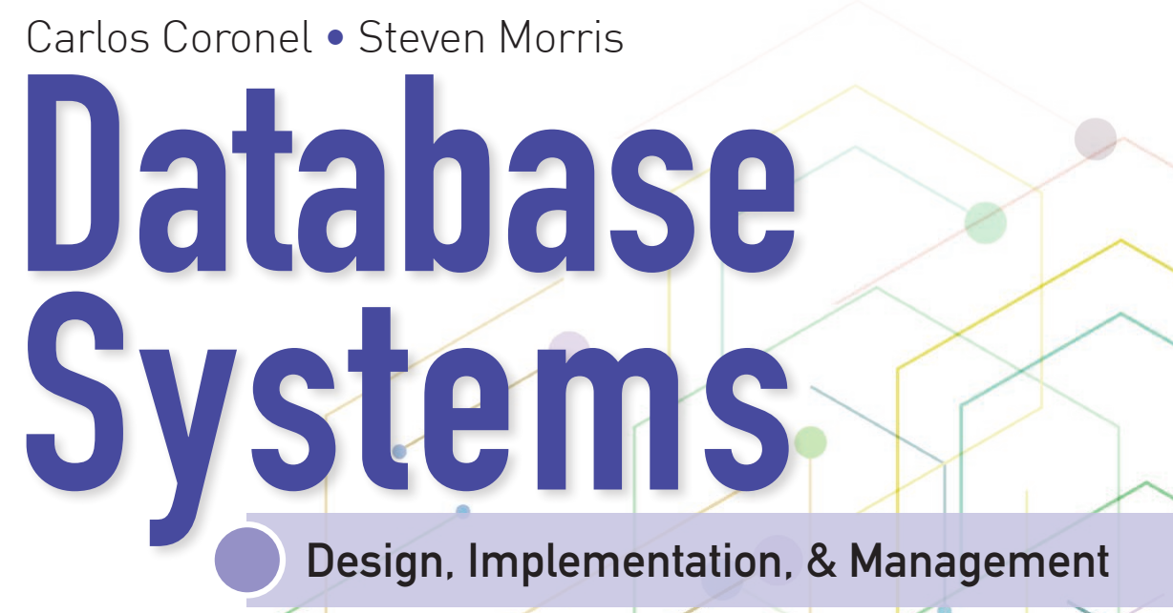
Learning Objectives
Define the difference between data and information
Describe what a database is, the various types of databases, and why they are valuable assets for decision making
Explain the importance of database design
Outline how modern databases evolved from file systems
Identify flaws in file system data management
Outline the main components of the database system
Describe the main functions of a database management system (DBMS)

Slide 2


National Economics University Faculty of Data Science & Artificial Intelligence
Database System Design, Implementation And Management Course – The Relation Database Model
Instructor: Duc Minh Vu (FDA – SLSCM Lab)
Email: minhvd [at] neu.edu.vn
12/19/2024
Database System Design, Implementation And Management
2

Slide 3
Learning Objectives
Describe the relational database model’s logical structure
Identify the relational model’s basic components and explain the structure, contents, and characteristics of a relational table
Use relational database operators to manipulate relational table contents
Explain the purpose and components of the data dictionary and system catalog
Identify appropriate entities and then the relationships among the entities in the relational database model
Describe how data redundancy is handled in the relational database model
Explain the purpose of indexing in a relational database

Slide 4
Introduction
Good decisions require good information derived from raw facts
Data is managed most efficiently when stored in a database
Databases evolved from computer file systems
Understanding file system characteristics is important

Slide 5
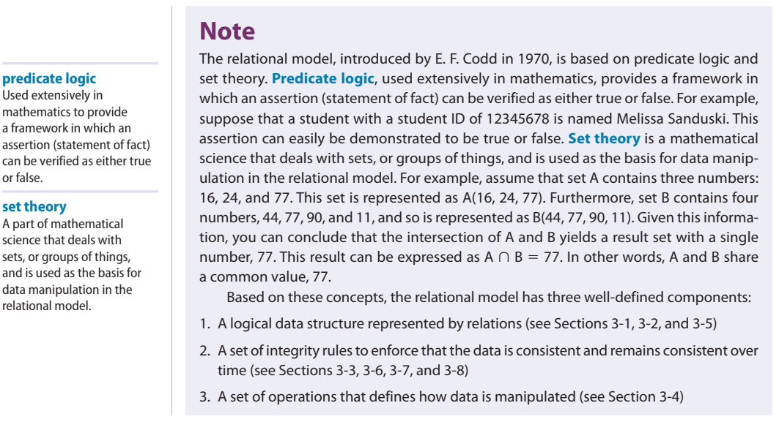

Slide 6
3-1 A Logical View of Data
Database stores and manages both data and metadata.
DBMS manages and controls access to the data and the database structure.
Such an arrangement—placing the DBMS between the application and the database—eliminates most of the file system’s inherent limitations. The result of such flexibility, however, is a far more complex physical structure.
Database structures required by both the hierarchical and network database models often become complicated enough to diminish efficient database design.
The relational data model allows the designer to focus on the logical representation of the data and its relationships, rather than on the physical storage details.
The relational model enables you to view data logically rather than physically.

Slide 7
3-1a Tables and Their Characteristics
A table is perceived as a two-dimensional structure composed of rows and columns.
A table is also called a relation because the relational model’s creator, E. F. Codd, used the two terms as synonyms.
Think of a table as a persistent representation of a logical relation—that is, a relation whose contents can be permanently saved for future use.
A table contains a group of related entity occurrences—that is, an entity set
The terms entity set and table are often used interchangeably

Slide 8
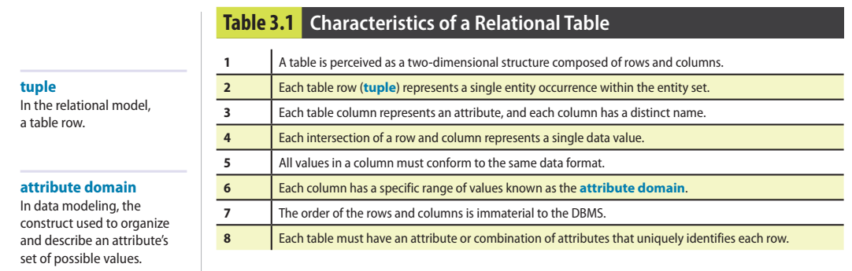

Slide 9
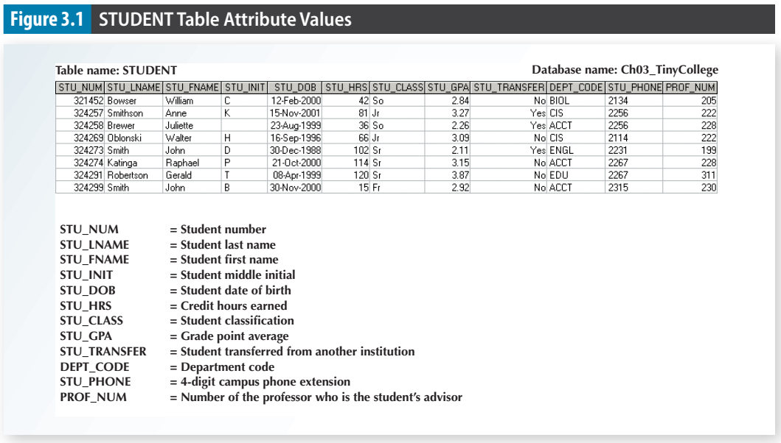

Slide 10
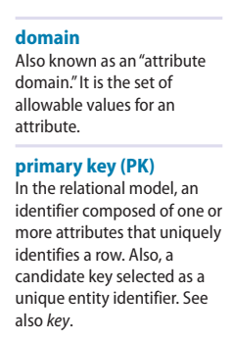
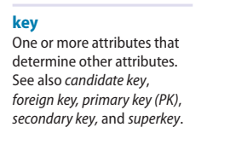
3-2 Keys
A key consists of one or more attributes that determine other attributes

Slide 11
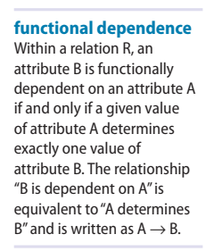
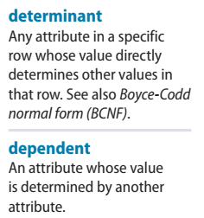
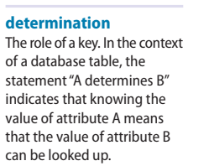
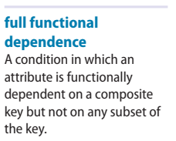
3-2a Dependencies
Determination is the state in which knowing the value of one attribute makes it possible to determine the value of another.
Functional dependence: the value of one or more attributes determines the value of one or more other attributes.
Key - Determinant: Attribute whose value determines another
Dependent: Attribute whose value is determined by the other attribute

Slide 12
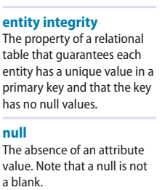
3-2b Types of Keys
A composite key is a key that is composed of more than one attribute.
An attribute that is a part of a key is called a key attribute.
A superkey is a key that can uniquely identify any row in the table
A candidate key is a minimal superkey—that is, a superkey without any unnecessary attributes.
Entity integrity is the condition in which each row (entity instance) in the table has its own known, unique identity

Slide 13
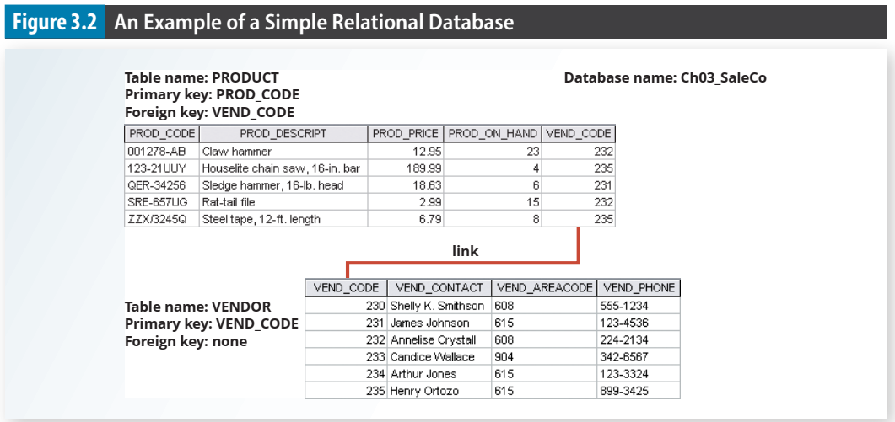

Slide 14
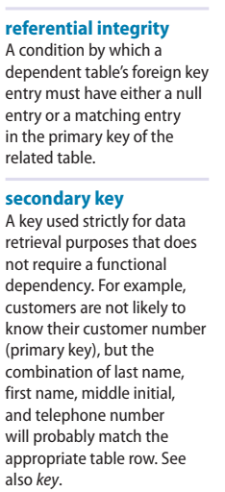
3-2b Types of Keys
A foreign key (FK) is the primary key of one table that has been placed into another table to create a common attribute.
Foreign keys are used to ensure referential integrity, the condition in which every reference to an entity instance by another entity instance is valid.
A secondary key is defined as a key that is used strictly for data retrieval purposes and does not require a functional dependency

Slide 15
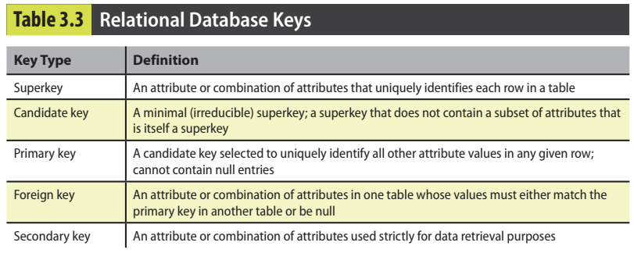

Slide 16
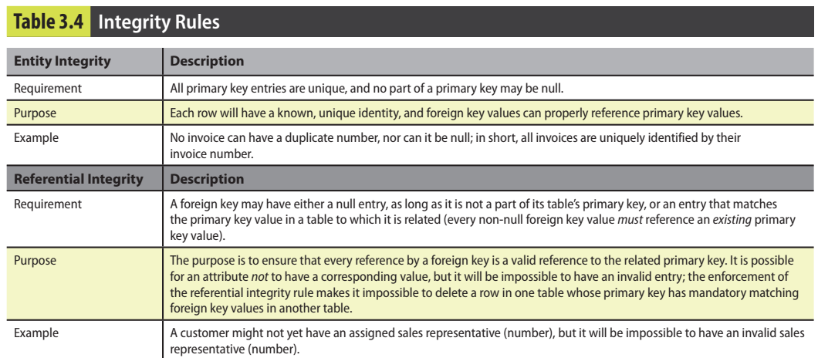
3-3 Integrity Rules

Slide 17
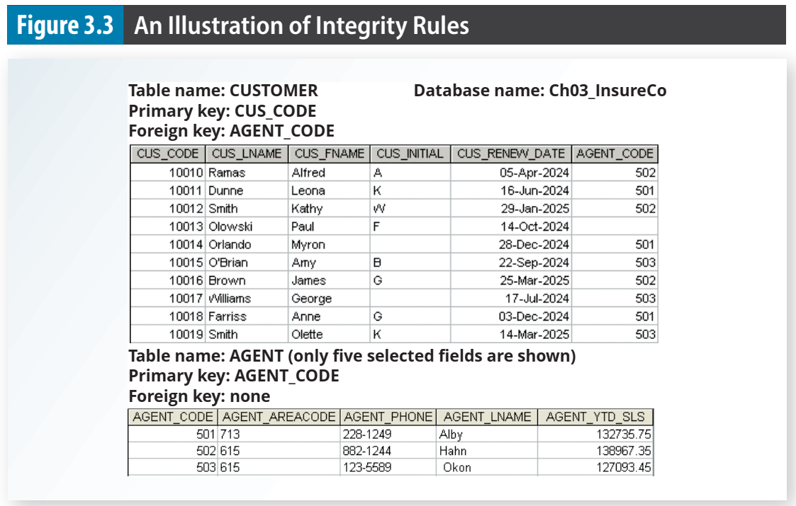

Slide 18
3-3 Integrity Rules (cont’d.)
Entity integrity.
The CUSTOMER table’s primary key is CUS_CODE. The CUSTOMER primary key column has no null entries, and all entries are unique.
The AGENT table’s primary key is AGENT_CODE, and this primary key column is also free of null entries.
Referential integrity.
The CUSTOMER table contains a foreign key, AGENT_CODE, that links entries in the CUSTOMER table to the AGENT table.
The CUS_CODE row identified by the (primary key) number 10013 contains a null entry in its AGENT_CODE foreign key because Paul F. Olowski does not yet have a sales representative assigned to him. The remaining AGENT_CODE entries in the CUSTOMER table all match the AGENT_CODE entries in the AGENT table.

Slide 19
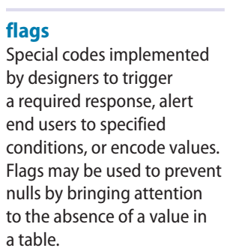
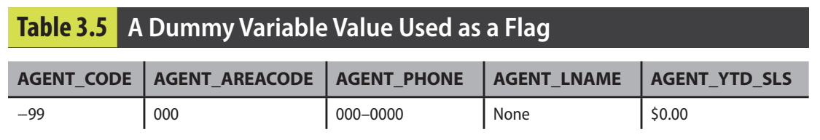
To avoid nulls, some designers use special codes, known as flags, to indicate the absence of some value

Slide 20
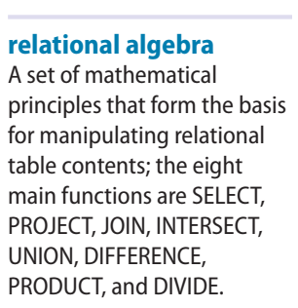
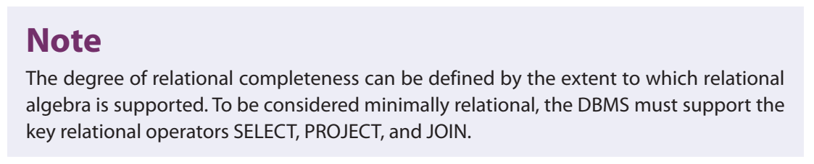
3-4 Relational Algebra
Relational algebra defines the theoretical way of manipulating table contents using relational operators.

Slide 21
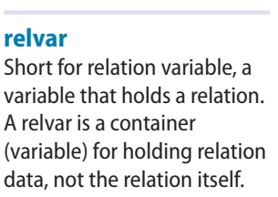
3-4a Formal Definitions and Terminology
A relation is the data in your tables.
A relvar is a variable that holds a relation.
A relvar has two parts: the heading and the body.
The relvar heading contains the names of the attributes, while the relvar body contains the relation.
To conveniently maintain this distinction in formulas, an unspecified relation is often assigned a lowercase letter (e.g., “r”), while the relvar is assigned an uppercase letter (e.g., “R”).
You could then say that r is a relation of type R, or r(R)

Slide 22
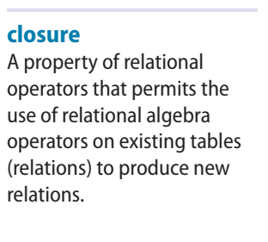
3-4b Relational Set Operators
The relational operators have the property of closure;
The use of relational algebra operators on existing relations (tables) produces new relations
the focus will be on the SELECT (or RESTRICT), PROJECT, UNION, INTERSECT, DIFFERENCE, PRODUCT, JOIN, and DIVIDE operators.

Slide 23
3-4b Relational Set Operators
SELECT, also known as RESTRICT, yields values for all rows found in the table that satisfy a given condition.
PROJECT yields all values for selected attributes. PROJECT yields a vertical subset of a table.
UNION combines all rows from two tables, excluding duplicate rows. The tables must have the same attribute characteristics (union-compatible).
INTERSECT yields only the rows that appear in both tables. The tables must be union-compatible.
DIFFERENCE (subtraction) yields all rows in one table that are not found in the other table.
PRODUCT yields all possible pairs of rows from two tables—also known as the Cartesian product.

Slide 24
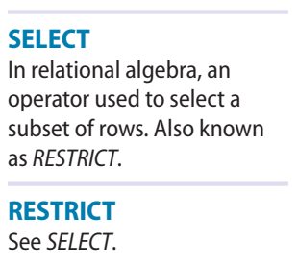
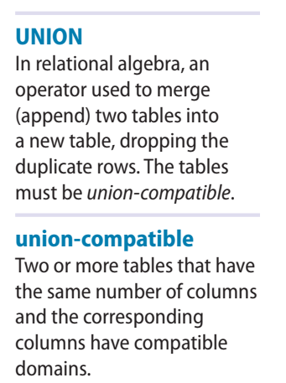
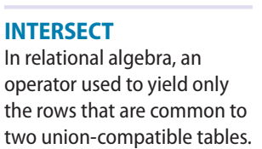
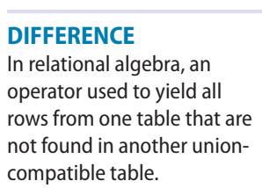
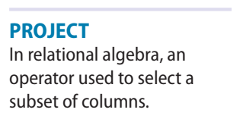

Slide 25
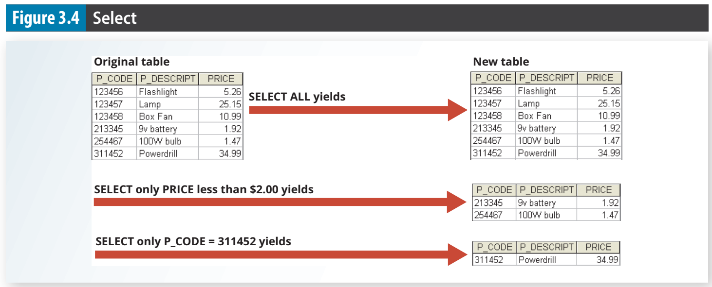

Slide 26
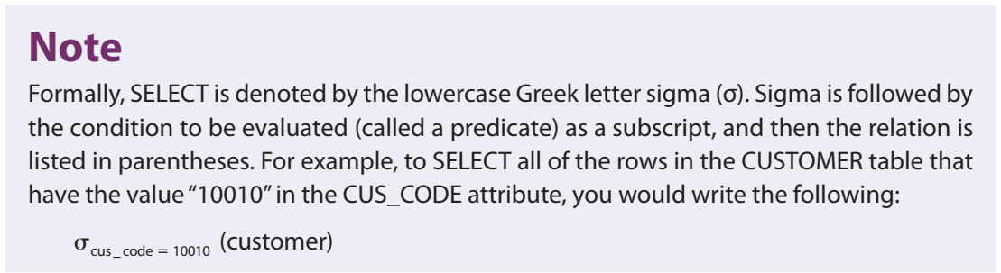

Slide 27
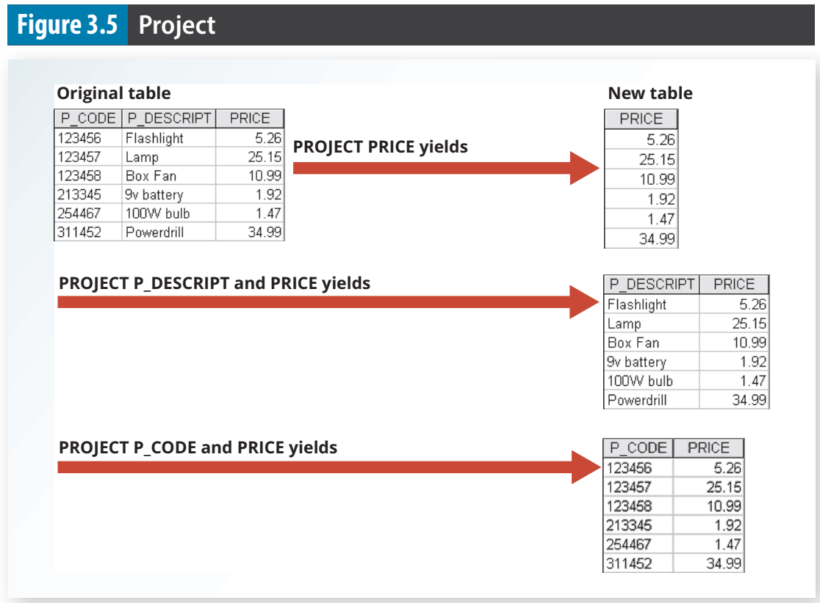

Slide 28
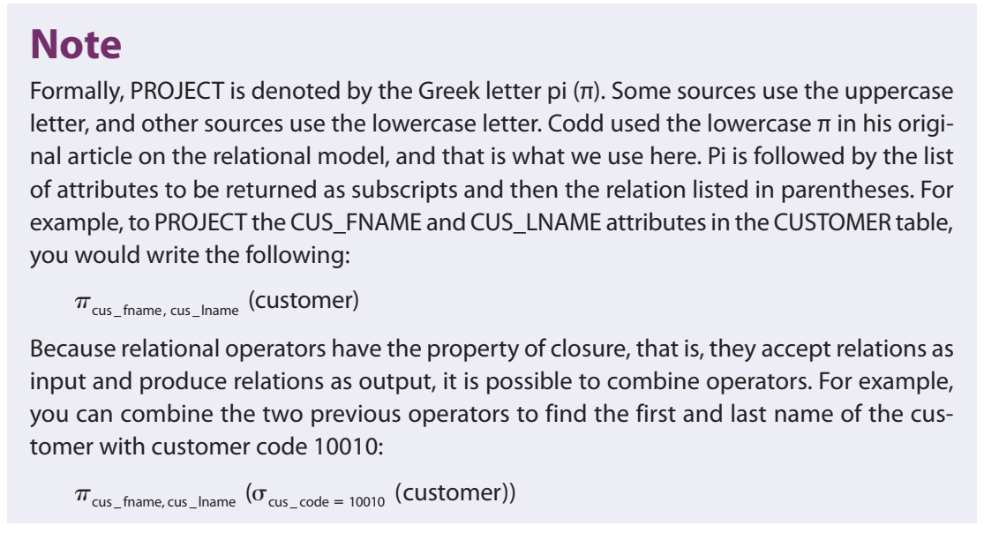

Slide 29
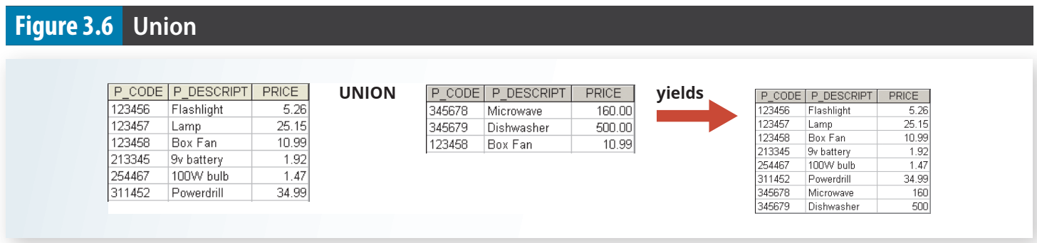

Slide 30
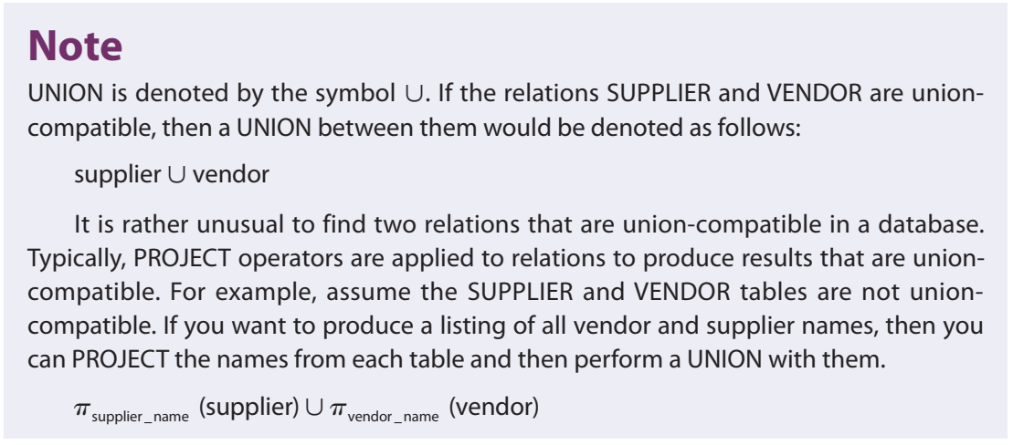

Slide 31
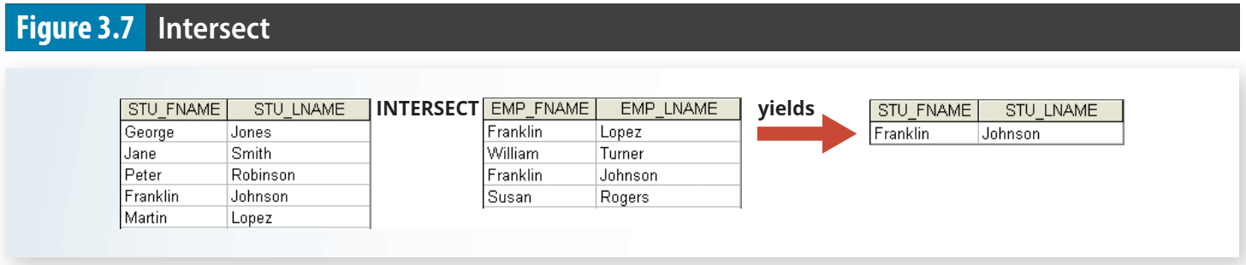

Slide 32
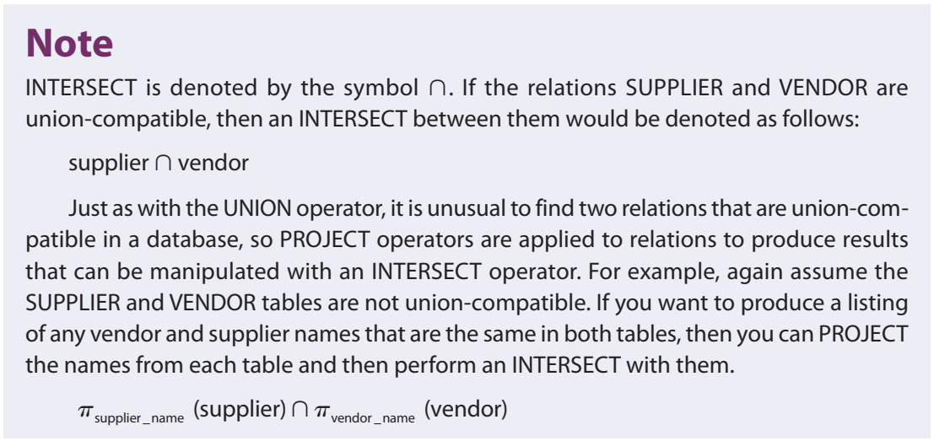

Slide 33
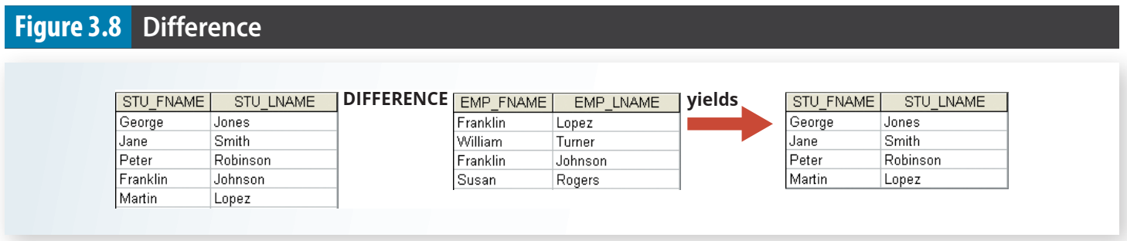

Slide 34
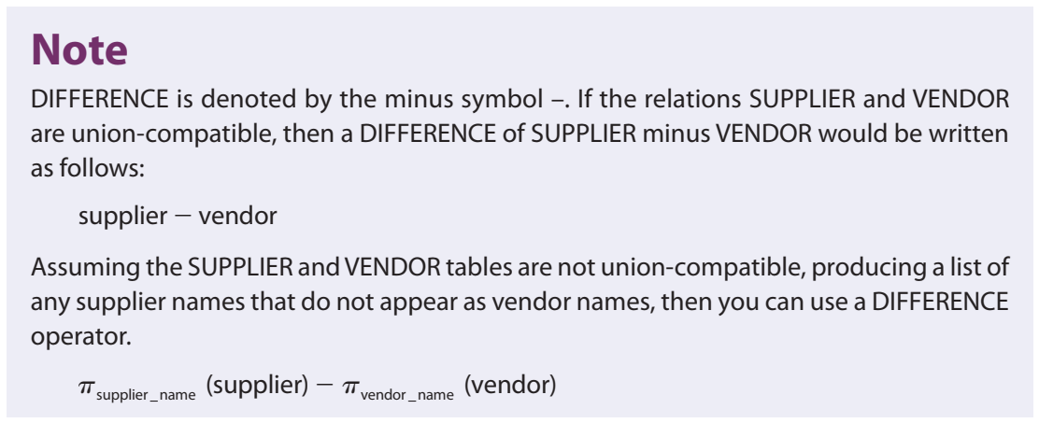

Slide 35
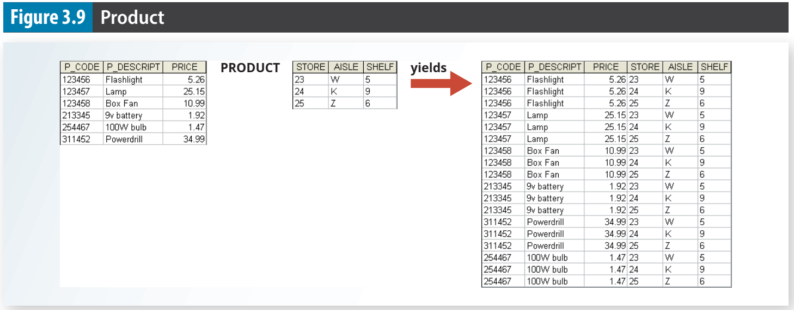

Slide 36
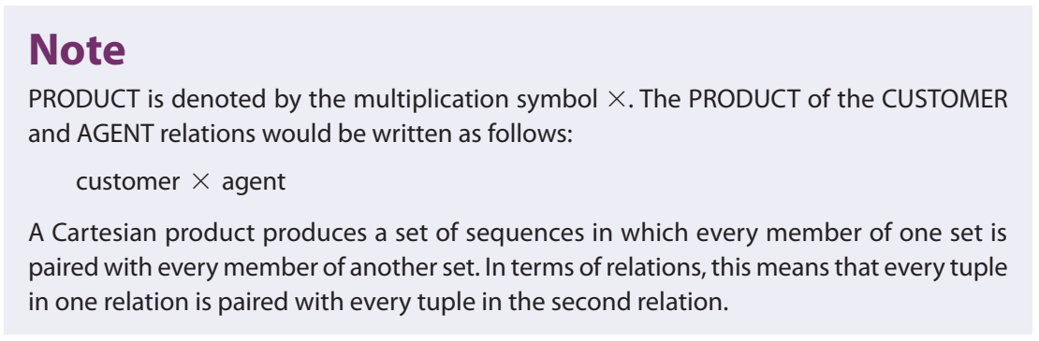

Slide 37
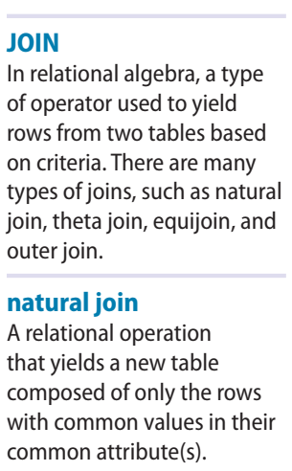
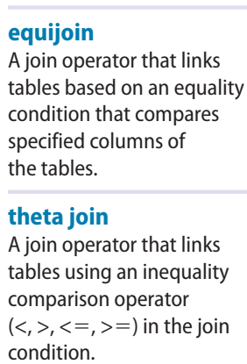
3-4b Relational Set Operators
JOIN allows information to be intelligently combined from two or more tables.
A natural join links tables by selecting only the rows with common values in their common attribute(s).
Equijoin, links tables on the basis of an equality condition that compares specified columns of each table. The outcome of the equijoin does not eliminate duplicate columns.
If any other comparison operator is used, the join is called a theta join.

Slide 38
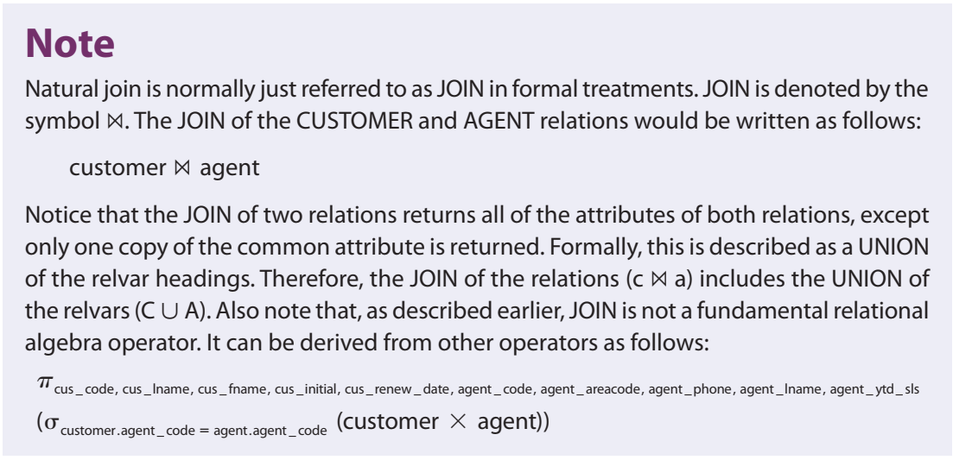

Slide 39
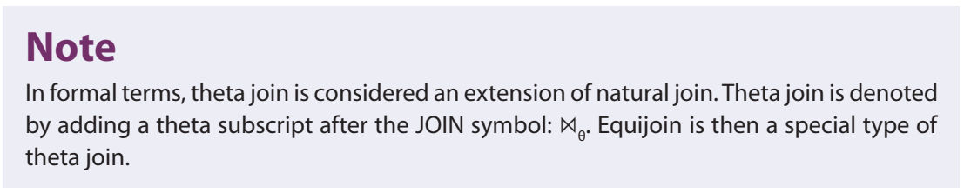

Slide 40
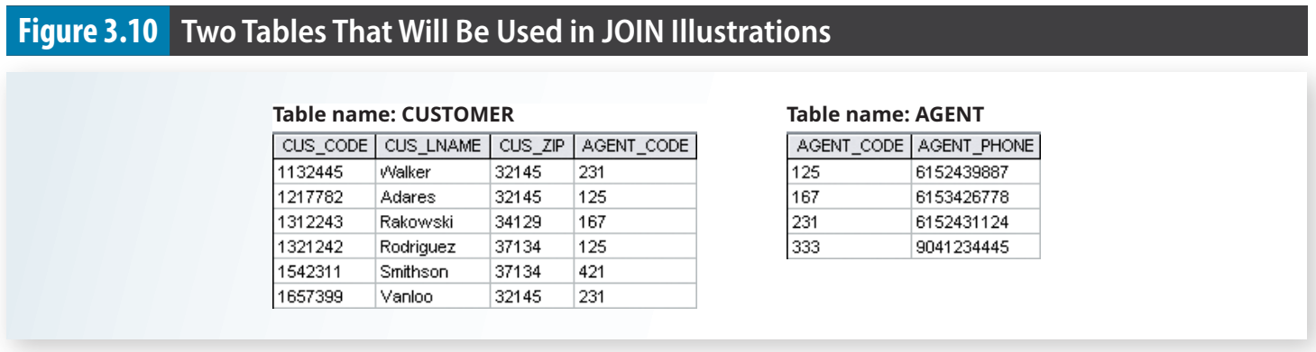
A natural join links tables by selecting only the rows with common values in their common attribute(s). A natural join is the result of a three-stage process:

Slide 41
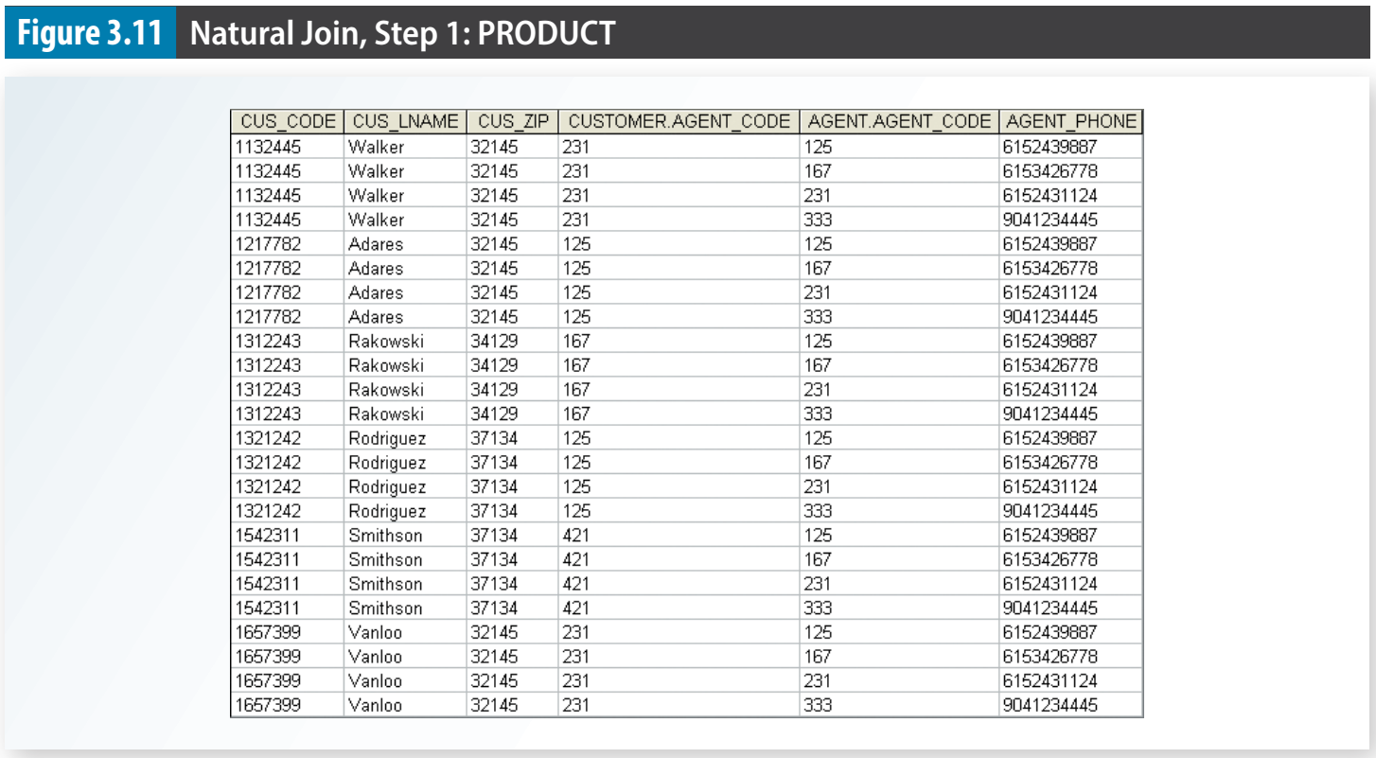
1. First, a PRODUCT of the tables is created, yielding the results shown in Figure 3.11.

Slide 42
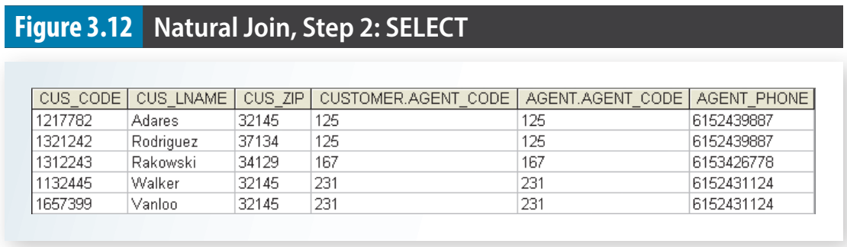
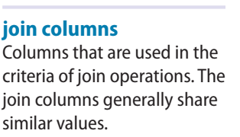
2. Second, a SELECT is performed on the output of Step 1 to yield only the rows for which the AGENT_CODE values are equal. The common columns are referred to as the join columns. Step 2 yields the results shown in Figure 3.12.

Slide 43
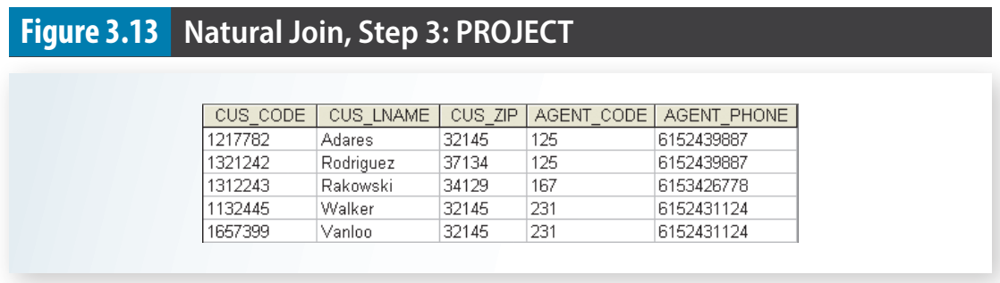
3. A PROJECT is performed on the results of Step 2 to yield a single copy of each attribute, thereby eliminating duplicate columns. Step 3 yields the output shown in Figure 3.13.

Slide 44
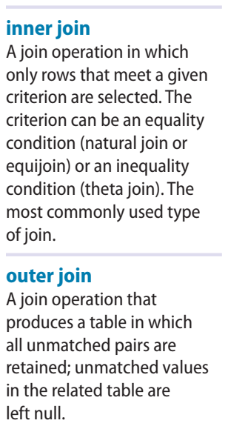
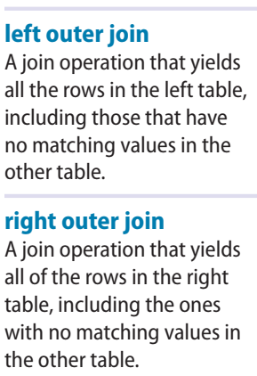
3-4b Relational Set Operators (cont’d.)
An inner join returns matched records from the tables that are being joined.
In an outer join, the matched pairs would be retained, and any unmatched values in the other table would be left null.

Slide 45

A left outer join yields all of the rows in the CUSTOMER table, including those that do not have a matching value in the AGENT table. An example of such a join is shown in Figure 3.14

Slide 46

A right outer join yields all of the rows in the AGENT table, including those that do not have matching values in the CUSTOMER table. An example of such a join is shown in Figure 3.15.

Slide 47


3-4b Relational Set Operators (cont’d.)
The DIVIDE operator is used to answer questions about one set of data being associated with all values of data in another set of data.
The DIVIDE operation uses one double-column table (Table 1) as the dividend and one single-column table (Table 2) as the divisor.

Slide 48


Slide 49


3-5 The Data Dictionary and the System Catalog
Data dictionary provides a detailed description of all tables in the database.
Contains at least all of the attribute names and characteristics for each table in the system. The data dictionary contains metadata—data about data.
System catalog can be described as a detailed system data dictionary that describes all objects within the database (table names, a table’s creator and creation date, number of columns in each table …)
System catalog is a system-created database whose tables store the user/designer-created database characteristics and contents.
Can be queried just like any user/designer created table.

Slide 50


3-5 The Data Dictionary and the System Catalog
System catalog automatically produces database documentation.
As new tables are added to the database, that documentation also allows the RDBMS to check for and eliminate homonyms and synonyms.
The word homonym indicates the use of the same name to label different attributes.
a synonym is the opposite of a homonym and indicates the use of different names to describe the same attribute.

Slide 51

3-6 Relationships within the Relational Database
The one-to-many (1:M) relationship is easily implemented in the relational model by putting the primary key of the “1” side into the table of the “many” side as a foreign key.

Slide 52

3-6 Relationships within the Relational Database
One entity in a 1:1 relationship can be related to only one other entity, and vice versa.
one department chair—a professor—can chair only one department, and one department can have only one department chair

Slide 53

Each professor belongs to a department

Slide 54

Each department is chaired by a professor.
So 1:1?

Slide 55

3-6c The M:N Relationship
A many-to-many (M:N) relationship is not supported directly in the relational environment.
M:N relationships can be implemented by creating a new entity in 1:M relationships with the original entities

Slide 56


Slide 57



Slide 58


Slide 59

3-9 Codd’s Relational Database Rules

Slide 60

3-9 Codd’s Relational Database Rules

Slide 61


Slide 62


Slide 63


